Slide 1
Cole Harbour Bel Ayr
Minor Hockey Association
2018 - 2019
Annual General Meeting
June 4, 2019

Slide 2
Team Recognition

Slide 3
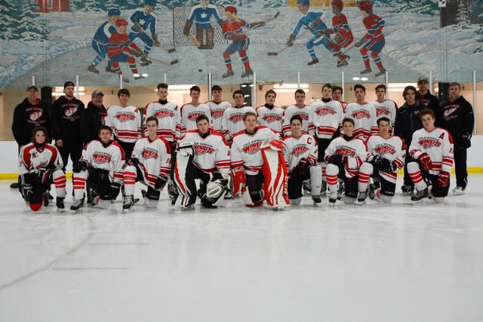
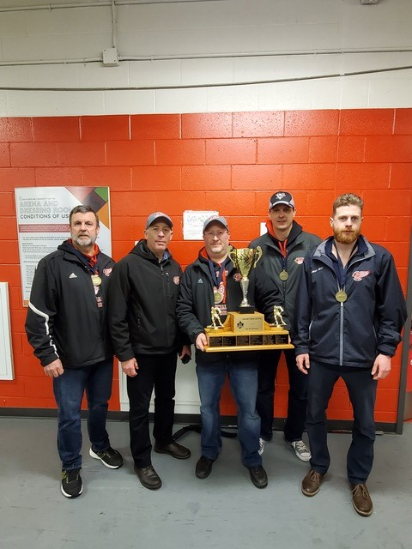
Midget B
Midget B Southern Conference Champions 2018-2019
Midget B Provincial Champions 2018-2019
CMHF- Tournament of Champions
CMHF League Champions

Slide 4
Recognition
Paul Cox Award for CHBA Volunteer
Outgoing Directors
Seamus Flynn Memorial Award

Slide 5
AGM 2018-2019 Agenda
Recognition - Presentation
Opening Comments – President Jim Bungay
Call to Order
Motion for approval of 2018 Draft AGM Meeting minutes
(Draft minutes are posted on Website)
Introduction of the current Board of Directors & Executive Reports
Presentation / Motion for Acceptance of Budget 2019-2020
Introduction of the 2019-2020 CHBA Board of Directors
NEW BUSINESS
5.1 Exploration of merging with Dartmouth and Eastern Shore
QUESTION FROM MEMBERSHIP
Motion of Adjournment

Slide 6
Current Board of Directors
President Jim Bungay
Past President Vacant
Vice President Perry Mason
Treasurer Jamie Miles
Managers Coordinator Yvette Considine
Equipment Manager Angela MacNeil
Novice/IP Coordinator Cindy Bell-McNeil
Ice Scheduler Paul Thibideau
Risk Management Michelle Lassaline
Rep Coordinator Jamie Aalders
Registrar Susan Manning
Media Coordinator Vacant
Rec League Coordinator Joel Wright
Joe La Montagne Liaison Darryl Braine
Secretary Jennifer Courtney
Referee-in-Chief Jason Clark

Slide 7
Approval of the Minutes of the
Preceding Annual General Meeting
June 7th, 2018

Slide 8
Director Reports

Slide 9
President Jim Bungay

Slide 10
Vice President
Perry Mason

Slide 11
CHBAMHA Vice-President's Report
2019 AGM
Perry Mason
Once again a majority of my time was focused on suspensions and disciplinary matters and the following is a brief summary of that activity:
Suspensions/Discipline:
In 2018-19 we had a total of 29 players and 3 coaches receive suspensions from HNS totalling 116 games, although two players received time suspensions which resulted in at least another 15 games being missed. There were 6 players who received multiple suspensions during the year. Again fighting and checking from behind were two of the largest contributors to player related suspensions which were similar in last year’s incidents. The real concern is the growing number of suspensions related to head contact (6X more) and the use of discrimatory slurs (3X more) and players and coaches making a travesty of the games(2X more). Two of our players received timed suspensions, one which was 45 days from HNS.

Slide 12
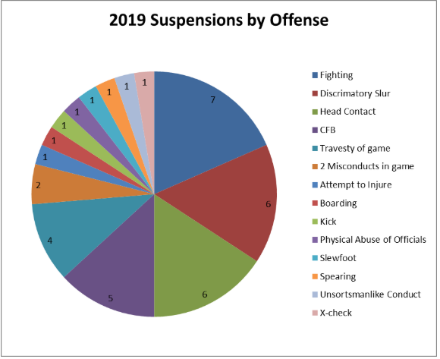

Slide 13
·
The number of suspensions is similar to the past couple of years, but the related games increased by almost 50%. This reflects the seriousness of general the conduct of some players which is disturbing. The number of discrimatory slurs reported to HNS province wide was unprecedented this year and will be a focus of HNS for this coming season.

Slide 14
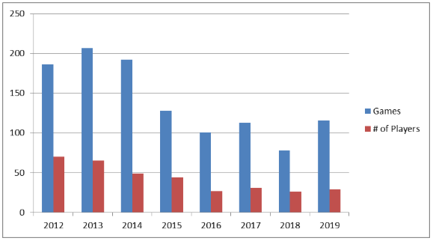

Slide 15
· Six incidents required a review by a HNS discipline committee before the final suspension was levied, twice as many as last year.
· We had four incidents that were required to be addressed by internal ad-hoc committees regarding behaviour of members-volunteers.
Thank you for allowing me to serve in the VP position for the past year. I look forward to serving the association for another year if I am elected into the VP position again.
Respectfully submitted,
Perry Mason

Slide 16
Registrar
Susan Manning

Slide 18
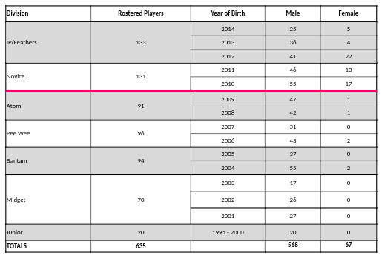

Slide 19
Risk Management Michelle Lassaline

Slide 20
Risk Management
244 rostered coaches, assistant coaches, trainers, on-ice helpers and managers - up from 225 last season.
244 completed required certification and checks. This is 100% compliance; up from 97% last year.
CRC Night (October 18) - 94 records were requested for at total cost of $2,820. Down from the 2017-18 cost of $2,880.
Hockey NS coach and safety courses - in total, 76 sessions both online and classroom at a total cost $6,754. Down from the 2017-18 cost of $7,212.
Certifications due to expire in 2019 will do so on August 31.

Slide 21
Rep Coordinator Jamie Aalders

Slide 22
Tryout Process
-Dal evaluators plus coaches, more data points
-Feedback from survey
-Increased goalie evaluations
-Call for volunteers

Slide 23
Development
-Development camps added
-In season development plans
-Interaction with refs

Slide 24
Pee Wee AAA League
-Province wide, 16 teams, top 6 make provincials
-Play every team twice, 3 mandatory tournaments
-Cole Harbour and Eastern Shore 1 region
-Cole Harbour still runs team and coaching selection

Slide 25
Coaches
-Early July call for coaches
-Position specific training
-More resources
-Survey results

Slide 26
Rec “C” Coordinator Joel Wright

Slide 27
Ice Scheduler Paul Thibideau

Slide 28
Ice Purchased 2018/19 - $ 371,972 (2017/18 – $ 361,818)
Ice Sold 2017/18 - $ 14,450
Total Cost of Ice 2017/18 - $ 357,522
CHP $ 307,438
Shearwater $ 38,442
Sportsplex $ 9,610
4 Pad $ 16,482
over 82% of the ice purchased last year was from CHP (Scotia 2 and Gray)
ICE SCHEDULER

Slide 29
Highlights:
Every Atom to Bantam rep team shared weekend early hours
CHP raised rates by $5 per hour
Melted ice was up slightly
132 hrs 2016/2017 ($22,527)
131 hrs 2017/2018 ($22,554)
103 hrs 2018/2019 ($20,050)
Next Year:
Try to secure more weekday prime time ice
Hoping no rate changes from CHP or other facilities
Peewee AAA will be a challenge
ICE SCHEDULER

Slide 30
Novice Coordinator Cindy Bell-McNeil

Slide 31
Novice Coordinator
Feathers - 1 Team
IP1 - 1 Team
IP2 - 2 Teams
Novice Development - 2 Teams
Novice Intermediate - 2 Teams
Novice Advanced - 2 Teams
Novice Female - 1 Team
We purchased a second set of the smaller novice nets this season to go with our half ice boards.
A huge thank you to all of our coaches, managers and volunteers this season!

Slide 32
Referee In Chief Jason Clark

Slide 33
Assign ref’s for ALL hockey in CHMHA / Joe

Slide 34
Joe Lamontange Tournament Liaison Darryl Braine

Slide 35
This year we had 147 teams in the Joe, 27 of them from Cole Harbour.
– 15 competitive and 3 novice divisions.
– We had three CH teams reach the finals and the CH BantamAA’s won their division.
We used Scotia 1 and 2, Shearwater, Lebrun and the Dartmouth 4 pad. In 2020 we hope to have all games played at SC1, SC2 and the RBC center.
No games were rescheduled in 2019 and championships were awarded in all divisions.
We had a new company look after the hospitality suite in 2019 and it was a great success..
All our financial commitments were met for 2019 and a modest profit turned.
We will continue to look at ways to reinvest in tournament infrastructure and to ultimately improve player experience.

Slide 36
Equipment Manager Angela MacNeil

Slide 37
Rebate from Pro Hockey Life for last season is $3000 in gift cards
$2500 cash
and up to $2500 in rebates*
Used to purchase coaches equipment, for new coaches, and goalie gear.
*based on purchases

Slide 38
Manager Coordinator Yvette Considine

Slide 39
Updated Volunteer Policy
revised volunteer cheque increase to $100
Updated Fundraising Policies
Revised allowable limit of Player Apparel to $125/player
all fundraising to be completed by January 31st
First season to keep all team bank accounts open May through September. Scotiabank will charge $2.50/month for this service. Took effect 2018-19 season.
Re-introduction of association 50/50

Slide 40
Volunteer Roles for 50/50
1. CHBA 50/50 Coordinator – non voting member, leader of 50/50 Committee
2. CHBA 50/50 Committee comprised of 5-10 people
3. Team 50/50 Funds Coordinator responsible for tracking sales, collecting sold tickets and funds for monthly draw
4. Team 50/50 Ticket Coordinator responsible for handing out and tracking ticket numbers for entire team
Basics
Each ticket will be sold for $2
$1 goes to the winner
$0.85 goes to the player/family selling the ticket. This can be used towards team budget or registration fees for the following season. Excess above that can be donated to another family for registration.
$0.15 used for Lottery License (percentage of prize) and printing of tickets
Mandatory player banks to be established – what you sell goes directly to player banks. Once player bank is filled, player profits will be linked to eHockey account for registration in the fall (credit will be applied upon checkout when registering)

Slide 41
Every player’s sales will be tracked by their team Funds Coordinator using an Excel Spreadsheet which will then be forwarded to the CHBA 50/50 Committee on a monthly basis.
50/50 Committee will make themselves available for ticket drop off twice monthly.
Team Fund’s Coordinator will drop tickets off to the 50/50 Committee before monthly draw is made. Will also provide a monthly cheque covering half of ticket sales and the lottery fee ($0.15/ticket sold). Cheque will be written to CHBA Lottery and will contain the number of tickets sold on the cheque.
Draws will be streamed live on the Association’s Facebook page with the winner being posted on Twitter, Instagram and on the CHBA webpage.
Year End
Monthly draws will start end of October 2019, and continue to be drawn at the end of every month until March.
A printed and emailed copy of the ticket tracker spreadsheet will be sent to the 50/50 committee.
All unsold tickets will be returned, bundled and labeled with: # of tickets, team name, and # of unaccounted tickets. Teams/players will be billed for any unaccounted tickets.
Team accounts will be debited April 3, 2020 for amount shown in the team tracker. This amount will be credited to each family’s following season registration.

Slide 42
Cost of Printing
Using red perforated cardstock will cost $0.067/ticket or $670 + tax for 10,000 tickets
Using white perforated cardstock will cost $0.053/ticket or $530 + tax for 10,000 tickets
At 17 players per team with 30 teams that’s approximately 20 tickets per player
As the season progresses, more tickets will be printed and handed out according to demand
Lottery Rules
Provincial lottery tickets can only be sold in NS. Tickets cannot be taken outside of NS to be sold, but people visiting NS are allowed to purchase tickets.
CHBA members are the only ones that can participate in selling 50/50 tickets.
Each draw will take place in the last few days of every month in a public place with no less than 2 witnesses present.
CHBA will track and collect all money in a separate account called CHBA Lottery. The NS Lottery Corporation will be paid 2.13% of the winnings at year end. A final report will also be submitted to the NS Lottery Corporation.
Individual association teams will not be allowed to obtain a 50/50 permit unless used for an auction fundraiser.

Slide 43
Treasurer Jamie Miles

Slide 44
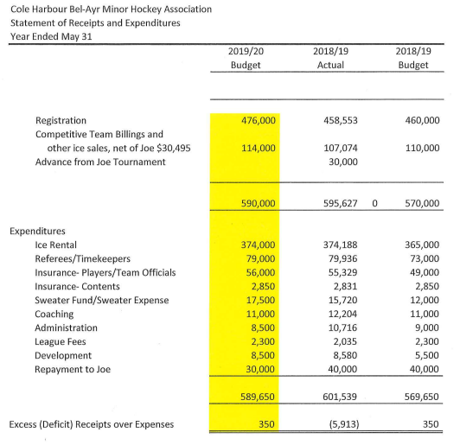

Slide 45
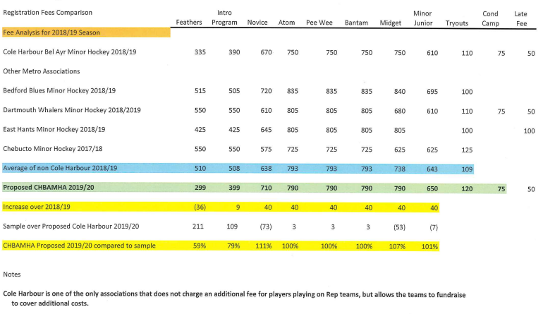

Slide 46
Web/ Communications Coordinator
Marty Cound

Slide 47
Roles:
-Goalline updates, Posting events, and team recognition.
-Facebook, Twitter, and Instagram feeds.
-Email communications.

Slide 48
5.0 New Business
5.1- Exploration of merging with Dartmouth and Eastern Shore

Slide 49
Election of Directors 2019 - 2020
Appointed Positions
Treasurer
Referee In Chief
Jason Clark

Slide 50
Elected Positions
By acclamation
Manager Coordinator
Equipment Manager
Ice Scheduler
Risk Management Coordinator
Registrar
Media Coordinator
Rec League Coordinator
Rep Coordinator
Joe Tournament Liaison
Secretary
Novice Coordinator
Yvette Considine
Marty Cound
Angela MacNeil
Tracey Cluett
Tara Dunn
Jamie Aalders
Joel Wright
Darryl Braine
Jennifer Courtney
Shannon Lander

Slide 51
Questions?

Slide 52
Motion for Adjournment

