Slide 2
AGM
ANNUAL GENERAL MEETING
June 19, 2023

Slide 3
AGENDA - June 19, 2023 @ Cole Harbour Place
Call to Order
President’s Welcome
Executive Reports
2022-2023 Financials
Executive Positions Elections or Acclamation
Question & Answer
Closing Remarks & Adjournment

Slide 4
2022-2023 CHBAMHA EXECUTIVE
President
Jamie Aalders
Vice President
Perry Mason
Registrar
Kary-Anne Young
Treasurer
Roberta Hupman
Secretary
Sandra Andrews
Ice Scheduler
Paul Thibideau
Referee-In-Chief
Jason Clark
Risk Management
Scott Graham
U7/U9 Coordinator
Chris Hunter
Equipment Manager
Marty Cound
Central Minor Representative
Kevin Cowper
Manager/Treasurer Coordinator
Mark Scholey
Recreational League Coordinator
Joel Wright
Representative League Coordinator
Kevin Cowper
Web/Communications Coordinator
Corrina Morris
Joe Lamontagne Tournament Liaison
Jeff McPhee

Slide 5
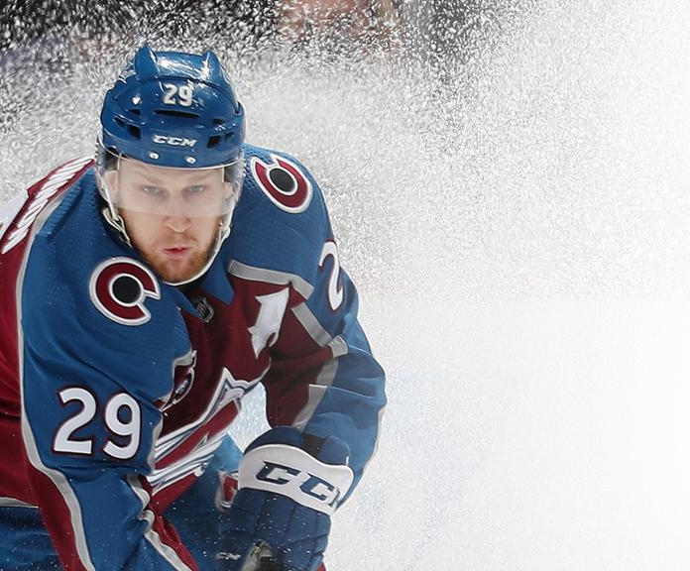
2023
2023
SIDNEY CROSBY
AWARD WINNERS
NATHAN MACKINNON
AWARD WINNERS
Jaxson Leroux
Dean Conrad
Max Sharp
Gavin Banfield
Joey Chidiac
Austin Forrest
Colby O’Shaughnessy
Breton Mcphee
Alex Sheppard
Lucas Mercer
Kane Houston
Aiden Hayman
Tyler Mackenzie
Connor O’Connell
Anthony Casavechia
Max Morash
Josh Naugle
Cole Pellerine
Brayden Currie
Dylan McMullen
Joey Edwards
Ian Blair
Quinn Wright
Vincent Simms
Owen Gilbert
Benoit Muise
Owen Power
Mitchell Randall
Tyler Balbino
Mason Morris
Blake Demill
Josh Misner
Josh Arsenault
Bryce Steele
Lyla Dauphinee
Avery Brownrigg
Alexander Rose
Luke Price
Colby Steele
Ben Macdonald
Andrew Hutchins
Keith Giffin
Ethan Wright
Brayden Cross
Kaia Lamore
Matthew Hatchette

Slide 6
PRESIDENT
JAMIE AALDERS

Slide 7
PRESIDENTS REPORT
22 CHAMPIONSHIPS INCLUDING LEAGUE TITLES, TOURNAMENTS AND PLAYOFFS/PROVINCIALS
AWARDS NIGHT WAS A HUGE SUCCESS, ALMOST 350 PEOPLE IN ATTENDANCE
EVERY TEAM WAS COMPETITIVE AND THE WINNING CULTURE CONTINUES TO BUILD
A LOT OF FORMER PLAYERS ARE BACK HELPING OUT AND NEXT YEAR WE WILL INTRODUCE A JUNIOR COACHING PROGRAM TO PROMOTE OUR YOUNG PLAYERS.
A BIG THANKS TO ALL OUR VOLUNTEERS
SURVEY COMING OUT SOON, WANT MEMBERS FEEDBACK ON HOW WE CAN IMPROVE
INTRODUCTION OF NEW VIDEO POLICY WITH HNS
ANOTHER SUCCESSFUL SEASON

Slide 8
U7/U9 Coordinator
CHRIS HUNTER

Slide 9
U7/U9 REPORT
U7 (2016-2018)
U9 (2014-2015)
U7 (2018) - 1 Team
U7 (2017) - 1 Team
U7 (2016/17) - 2 Teams
U7 (2016) - 1 Team
Development – 2 Teams
Intermediate – 2 Teams
Advancing – 2 Teams
A BIG thank you to all the coaches and volunteers for all your hard work this season!

Slide 10
First Shift - Hosted by Cole Harbour
Max 30 Co-ed participants (11 allocated for female hockey players)
19 boy spots filled in 17 mins!
24/30 spots filled - 6 remaining held for girls (can be filled with boys closer to deadline)
42 boys currently on waiting list
Welcome Night Nov 1st; Ice times TBD (Nov/Dec)

Slide 11
Ice Scheduler
Paul Thibideau

Slide 12
ICE REPORT
Wasted Ice Summary
Rates
2017/18 - $22,554
2018/19 - $20,050
2019/20 - $22,431
2020/22 - $6,246
2021/22 - $8,967
2022/23 - $11,900
CHP 2021/22 rate $180 per hour for prime time. CHP 2022/23 rate $211.14 per hour (which is the same as all HRM owned facilities).
Shearwater 2021/22 rate $200 per hour (no change expected).
East Coast Varsity 2021/22 rate $245 per hour (no change expected).
ICE RENTAL WAS SIGNIFICANTLY LOWER IN 2021/22 AND WILL BE INCREASING IN 2022/23

Slide 13
ICE REPORT
News & Notes
In 2022/23, ice was made available for goalie development. In 2023/24, an effort will be made to have more ice available for development for all members.
In 2022/23, games didn’t start until November which caused scheduling issues that lasted the entire season. In 2023/24, the games are supposed to start earlier so this should help with scheduling.
HRM has allocated the association 75 hours of ice per week for the 2023/24 season but we may not be able to secure 75 hours from CHP and Shearwater. All ice surfaces will be contacted to try to secure at least 75 hours.
In 2023/24, there will be more pressure on scheduling with the need for more development ice times, fitting in the Bauer First Shift program, the hopeful return of U13 AAA team and there is potential for U15 A and U13 AA games to be expanded to 90 minutes (80 minutes for the game and 10 minutes for resurfacing).
In 2022/23, C level teams had a lot of single team practices because of scheduling conflicts. In 2023/24, C level teams should expect more shared ice practices.

Slide 14
VICE PRESIDENT
PERRY MASON

Slide 15
VICE PRESIDENTS REPORT SUSPENSIONS/DISCIPLINE
34 Players Suspended
8 Coaches Suspended
186 Total GAMES Suspensions from Hockey NS

Slide 16
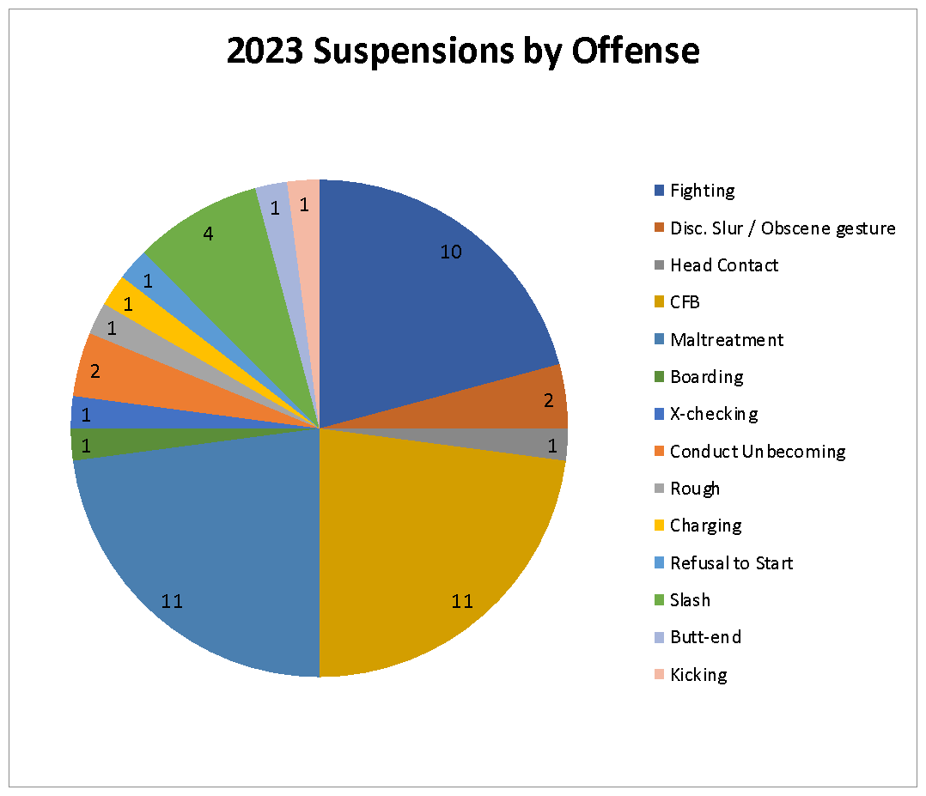
VICE PRESIDENTS REPORT- SUSPENSIONS/DISCIPLINE
In 2022-23 we had a total of 34 players and 8 coaches receive suspensions from HNS totalling 186 games almost twice last year’s total. This year we had six players who received multiple suspensions during the year. A majority of suspensions were associated with Checking from Behind (23%), Abuse Behaviour (23%) and fighting (21%). The most games for suspensions came from fighting, which is expected as the minimum suspension is 5 games, but not far behind was abusive behaviour which is something our association should be concerned about
We did have a number of issues with the behaviour of fans in the arena which aligns with the increased abusive behaviour we saw from our coaches and players. These actions have resulted in players being removed from the association due to the serious breaches of the Associations Code of Conduct.

Slide 17
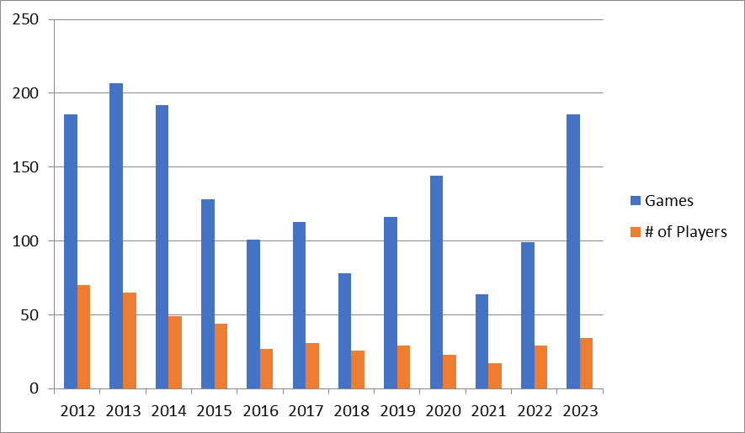
VICE PRESIDENTS REPORT SUSPENSIONS/DISCIPLINE
This year we had a dramatic increase in the number of games players and coaches were suspended, 186 in total. The numbers this year have not been seen for 9 years.

Slide 18
VICE PRESIDENTS REPORT SUSPENSIONS/DISCIPLINE
I would like to thank everyone who I had the opportunity to work with over the past 12 years as Vice President. I hope we continue to improve the quality of our programs for our members in general. I believe we have room for improvement, but certainly are progressing in the right direction.
Respectfully submitted,
Vice President Perry Mason

Slide 19
REGISTRAR
Kary-Anne Young

Slide 20
REGISTRAR REPORT - 2022-2023 REGISTRATION NUMBERS
598 Players
184 Coaches/Bench Staff
34 teams
11 Rep League (AA, A, B)
12 Rec (C level)
6 U9
5 U7
U13 AAA – 12 players rosters from CHBA
9 - (2010 Born )
3 - (2011 Born)

Slide 21
REGISTRAR REPORT - 2022-2023 REGISTRATION NUMBERS
DIVISION | ROSTERED PLAYERS
U7 (2016, 2017, 2018) | 106
U9 (2014, 2015) | 109
U11 (2012, 2013) | 93
U13 (2010,2011) | 102
U15 (2008, 2009) | 86
U18 (2005, 2006, 2007) | 86
Minor Junior (1999-2004) | 16
TOTALS | 601

Slide 22
REGISTRAR REPORT
Registration for 2022-2023 Season
Registration will open August 1st, 2023
Payment plan for this season will be available, dates are TBA
All fees must be paid in full before your player can go on the ice

Slide 23
REPRESENTATIVE LEAGUE COORDINATOR
KEVIN COWPER

Slide 24
REP LEAGUE COORDINATOR REPORT
Conditioning Camp 2022
DIVISION | Reg. PLAYERS
U9 (2014, 2015) | 81
U11 (2012, 2013) | 66
U13 (2010,2011) | 77
U15 (2008, 2009) | 54
U18 (2005, 2006, 2007) | 42
TOTALS | 320

Slide 25
REP LEAGUE COORDINATOR REPORT
Conditioning Camp 2022
Each Session had a Practice Plan for Coaches
Players grouped by previous level played
Consistent Coaching
Sessions 5 & 6 were Dry-Runs of Player Selection Process

Slide 26
REP LEAGUE COORDINATOR REPORT
2022-2023 Rep Team Selection Process for U11-U18 teams
Exceeded goal of 4-8 evaluators per session.
Sessions for Individual skills, tactical skills, and intrasquad games used for evaluations.
Many data points to prevent biased scoring.
U11 - 10 Evaluators, 85 data points
U13 - 11 Evaluators, 97 data points
U15 - 13 Evaluators, 108 data points
U18 - 8 Evaluators, 51 data points
End of process kids are at the right level for personal and team success.

Slide 27
REP LEAGUE COORDINATOR REPORT
This was year 5 of using the app
An easy-to-use mobile app for managing our team selection process including evaluating players, staying organized and ensuring data entered is secure.
Other customers now include Bedford, Sackville, Dartmouth, Halifax.

Slide 28
REP LEAGUE COORDINATOR REPORT
Pre Season Coach Development
Jon Greenwood (Assistant Coach SMU Hockey)
Defensive strategy and Development
Todd Bengert (Goal Scoring from a goalie perspective)

Slide 29
REP LEAGUE COORDINATOR REPORT
Development during 2022-2023 season
All teams were provided $500 support from the association to use at their own discretion for any bookings/registration on any combination of Goalie Development, Power Skating, and/or Game Performance skating.

Slide 30
REP LEAGUE COORDINATOR REPORT
REGULAR SEASON STATISTICS
*this year stats included all CMHL games
 | GP | W | L | T | WIN % | W/T %
2016-17 | 326 | 96 | 190 | 40 | 29% | 42%
2017-18 | 269 | 75 | 156 | 38 | 28% | 42%
2018-19 | 285 | 89 | 152 | 44 | 31% | 47%
2019-20 | 272 | 85 | 147 | 40 | 31% | 46%
2020-21 | 114 | 55 | 48 | 11 | 48% | 58%
2021-22 | 268 | 127 | 95 | 46 | 47% | 65%
2022-23 | 433 | 217 | 153 | 64 | 50% | 65%

Slide 31
REP LEAGUE COORDINATOR REPORT
12 Banners Won!
U11 B Joe Championship
U11 B Regular Season Champs
U11 B Sackville Fall Title
U11 B Playoff Champs
U11 B Provincial Champs
U11 A Joe Championship
U11 A Playoff champion
U11 AA Sedhma Accord Champs
U13 B Sackville fall title
U13 A Playoff Champion
U15 A Sedhma Accord Champs
U15 AA Quebec Cup Finalists
U15 AA Regular season title

Slide 32
REP LEAGUE COORDINATOR REPORT
Goalie Development
EVERY rep team had a designated goalie coach
Build a community of goaltenders
Built a better network of goalie support/coaches
Improve process to get goalies more ice-time with rep teams

Slide 33
REP LEAGUE COORDINATOR REPORT
Goalie Coach Program
Led by Todd Bengert (Upper Echelon Goaltending)
Rep Goalie Practices (12 Sessions)
Ambition Program (12 Sessions)
Todd also was on ice for many team practices
Todd will be back and the Program will be even better next season!

Slide 34
A Coach will impact more people in a year
than the average person does in a lifetime.
On behalf of the Association, parents and
players…
Thank you to our coaches.

Slide 35
RECREATIONAL LEAGUE COORDINATOR
JOEL WRIGHT

Slide 36
RECREATIONAL LEAGUE COORDINATOR
GOALIE DEVELOPMENT PROGRAM
Through the 2022/2023 season- Upper Echelon began working with the Rec Goalies in the Association. Each age group would have ice time twice a month with Todd Bengert at no extra cost to the team.
The feedback was overwhelmingly positive, the Goalies really enjoyed their time learning with Todd. Cole Harbour had two goalies winning The Joe Sidney Crosby Shootout in the Rec division which last year there was only 1.

Slide 37
Balancing
RECREATIONAL LEAGUE COORDINATOR
Balancing has been a very big component of the Recreation League at the beginning of the year, it is the Rec Coordinator’s goal to keep all the teams even in skill level .The overall standings of each team in their age group shows what a great job the evaluators are doing.
Standings in League Play
U11- Finished 2nd,4th and 8th
U13- Finished 1st, 2nd and 3rd
U15- Finished 2nd and 4th
U18- Finished 4th, 5th and 7th
Overall the Rec Division had a successful season. U13 is an example of this, finishing 1st, 2nd and 3rd respectively in league play. The U13 Red Wings won the Rec team of the year, capturing 4 Championships throughout the season and finished as the division's best team.

Slide 38
Rec Team of the Year
RECREATIONAL LEAGUE COORDINATOR
RECREATIONAL LEAGUE COORDINATOR
U 13 C RED WINGS
4X CHAMPIONS
THE MILLSTONE CUP (CITY CHAMPIONS)
DWRHL LEAGUE CHAMPIONS
COREY BATES AND NICK MERRIL
FRIENDSHIP TOURNAMENT
KYLE HENNEBERY MEMORIAL TOURNAMENT

Slide 39
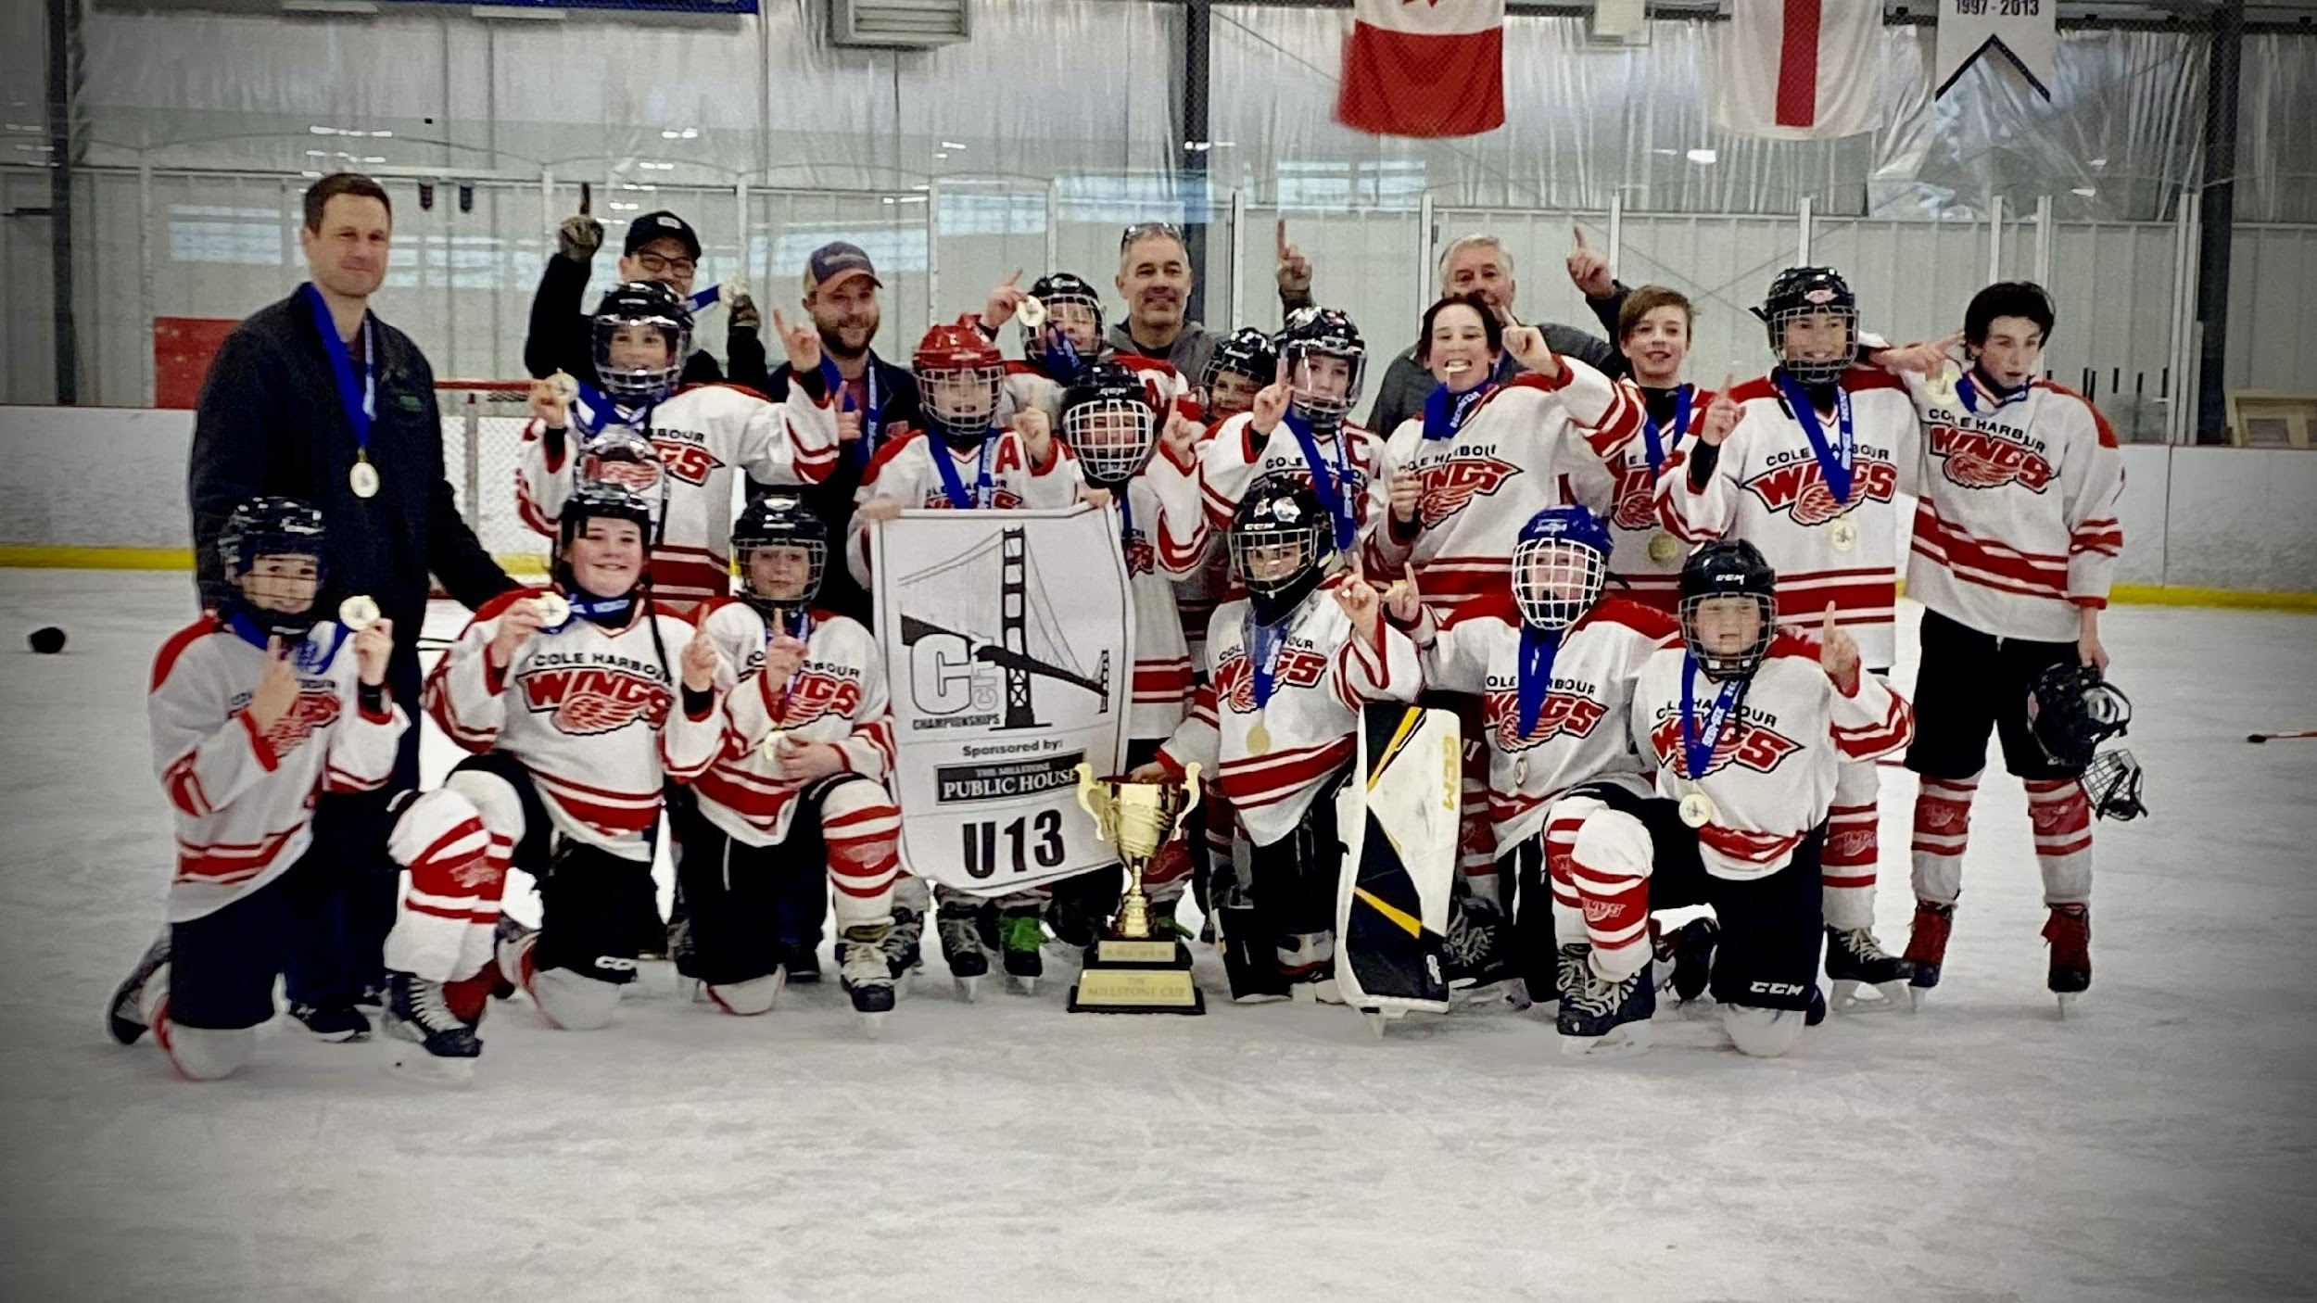
RECREATIONAL LEAGUE COORDINATOR
RECREATIONAL LEAGUE COORDINATOR
SAGE AMYOTTE-MACLEAN
OWEN ANDREWS
AVERY BROWNRIGG
SAMUEL COGHLIN
LIAM FRASER
AIDEN HAYMAN
MASON JOHNSON-HUNT
RYAN JONES
CARTER KAZMEL
DYLAN LAPIERRE
RYAN PERRY
BRAYDEN PURCELL
HARLEY REID
NOAH SCHAAY
MATEO VELUTINI
ROWAN VERRAN
U 13 C RED WINGS
Head Coach
Gary Hayman
Assistant Coach
Eric Durand
Assistant Coach
Josh Verran
Assistant Coach
Kevin Hurley
Assistant Coach
Shawn Perry
Equipment Manager
Andrew Kazmal
Manager
Anna Jones
Treasurer
Chris Coghlin

Slide 40
JOE LAMONTAGNE TOURNAMENT LIAISON
JEFF McPHEE

Slide 41
THE JOE REPORT
In house atmosphere was a main focus for 2023. Was harder to accomplish then expected due to technical issues with sound systems in the rinks. This was out of The Joe’s control. The bannering in RBC and Cole Harbour Place added to the in rink atmosphere.

Slide 42
THE JOE REPORT
First full tournament with hospitality suite,merchandise, no crowd restrictions since COVID
Tournament was a sell out again this year, and consideration is being given to increasing some of the rep divisions
Live round robin game for all Cole Harbour teams was well received and coverage for all Shootouts, Semis and Finals

Slide 43
THE JOE REPORT
Move to GrayJay pay platform for registration and tournament management in 2023 was a success, there were certainly challenges in the early stages, but overall a successful first year
Planning has started with booking and securing ice contracts for 2024
Championship On-Ice Sign for photos, and championship rings were well received, looking to build on these elements going forward

Slide 44
RISK MANAGER
SCOTT GRAHAM

Slide 45
RISK MANAGEMENT REPORT
Hockey Nova Scotia sets certification requirements for head coaches, assistant coaches,
managers, trainers and safety representatives
(https://hockeynovascotia.ca/coach/coaching-requirements)
Hockey Nova Scotia sets the certification deadline as December 1 each season
CHBAMHA does not have any flexibility or discretion in these deadlines or requirements
In 2022-23 we had 263 Team Staff qualified (up from 253 in 2021-22):
75 Rep - 100% certified
83 Rec - 100% certified
105 Novice - 100% certified
11 indefinite suspensions (qualifications incomplete; not completed on time) - up from 5 in 21/22 (the 11 includes the 5 from 21/22)

Slide 46
RISK MANAGEMENT REPORT
Increased options (Backcheck via Halifax Regional Police - 100% online and self-service RCMP)- more timely results
Risk Manager provided information for coaches
and attended managers/treasurers night to highlight expectations (communication, compliance)
Revised CHBAMHA Code of Conduct & Discipline
Policy; implemented conflict of interest and third
party coaches policies
Led Hockey NS Safer Sport Sub-committee
What we did in 2022-23
What we’re doing for 2023-24 Season
What we’re doing for 2022-23 Season
Continue with current options
Implement HNS changes for safety qualifications (at least one at U7/U9 HCSP Level II; All B/Rec have all HCSP Level I and at least one HCSP Level II; A/AA/AAA transition from all with HCSP 1 to all with HCSP III as certificates expire); Look into first aid program to help compliance
Implement HNS Changes for Emergency Action Plans (EAP); HNS keeping an EAP repository;First aid kits for teams (standard)

Slide 47
REFEREE-IN-CHIEF
JASON CLARK

Slide 48
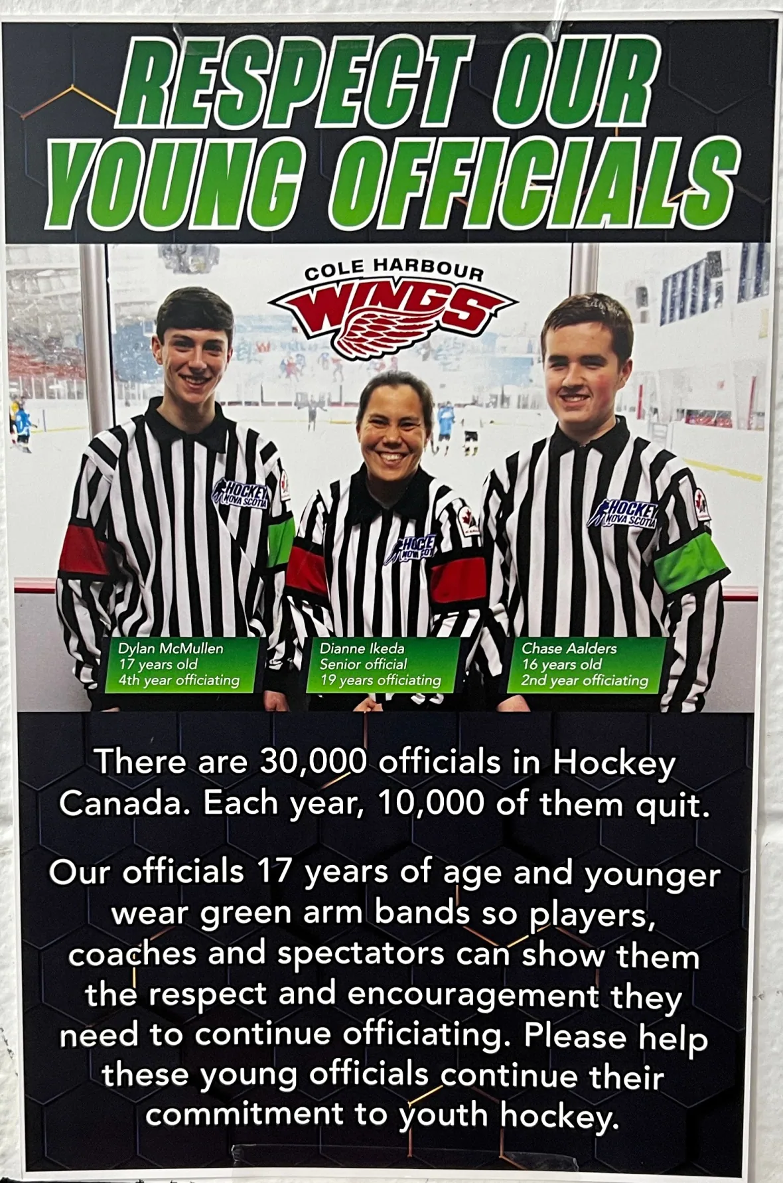
REFEREE –IN-CHIEF REPORT
GREEN ARMBAND INITIATIVE
We were the 1st association to roll out the Green Armband Initiative. Then they rolled it out across Nova Scotia a few weeks later. The green armband was a huge success, and was not 1 issue with any abuse of refs wearing green arm band.
Since rolling out, I have given a report to 17 other associations in Canada, and 2 from USA. Also did a report for Baseball Nova Scotia, and they have rolled it out for this summer. Also Lacrosse has rolled out arm band initiative.

Slide 49
REFEREE –IN-CHIEF REPORT
Other Notes
No games were cancelled due to ref absence. - a streak 10 years and counting!
Have changed that 1st year Referees need to be in 2nd year Bantam now.

Slide 50
EQUIPMENT MANAGER
MARTY COUND

Slide 51
MANGER COORDINATOR
MARK SCHOLEY

Slide 52
TREASURER
ROBERTA HUPMAN

Slide 53
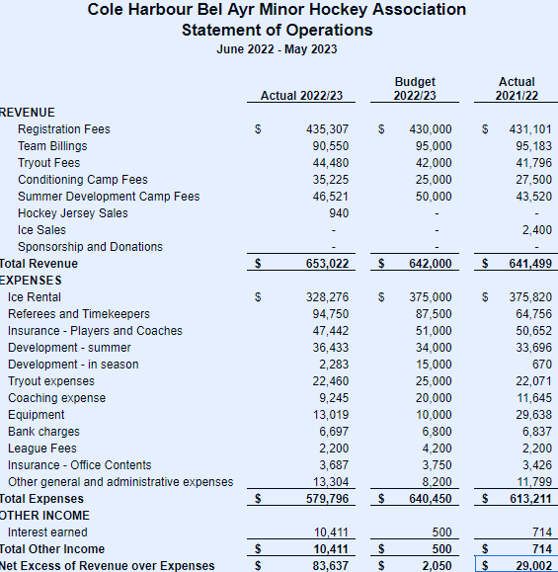
STATEMENT OF OPERATIONS – JUNE 2022-MAY 2023

Slide 54
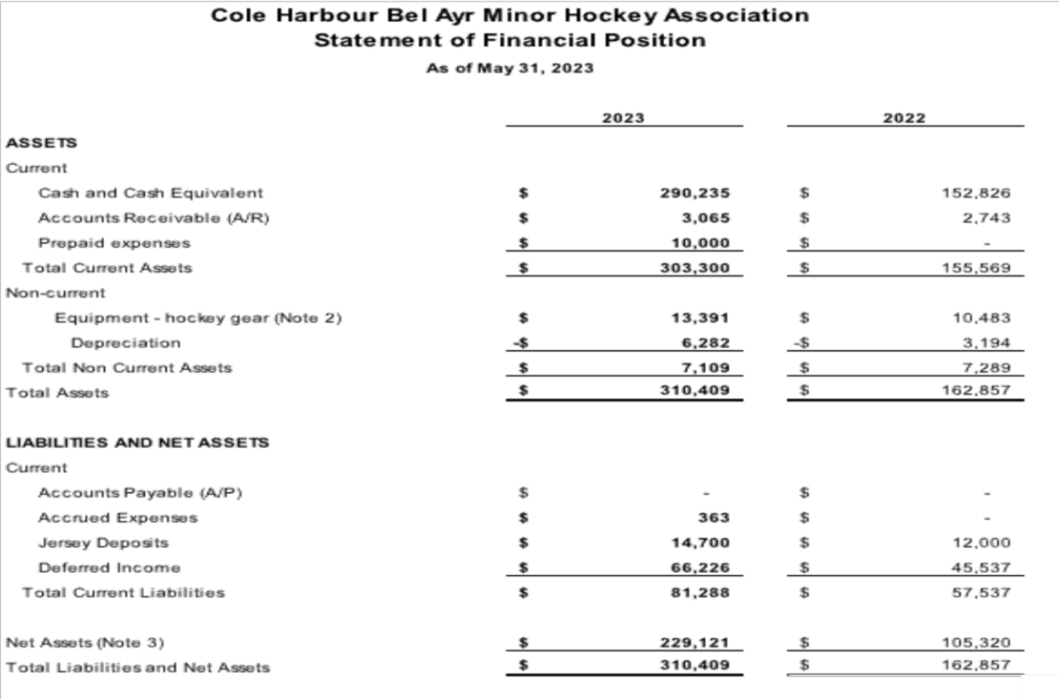
BALANCE SHEET AS OF MAY 31ST, 2023

Slide 55
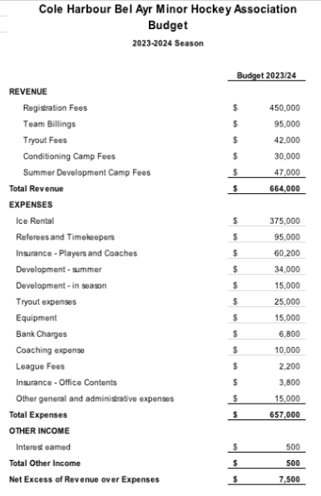
BUDGET 2023-2024 SEASON

Slide 56
Election of Directors 2023 - 2024
Positions
Vice President
Equipment Manager
Web/Communication Coordinator
Risk Management
All these positions were open positions, prior member has stepped down for the upcoming season.

Slide 57
2023-2024 CHBAMHA EXECUTIVE
President
Jamie Aalders
Vice President
Scott Graham
Registrar
Kary-Anne Young
Treasurer
Roberta Hupman
Secretary
Sandra Andrews
Ice Scheduler
Paul Thibideau
Referee-In-Chief
Jason Clark
Risk Management
TBD
U7/U9 Coordinator
Chris Hunter
Equipment Manager
Brian Hurdis
Central Minor Representative
Kevin Cowper
Manager/Treasurer Coordinator
Mark Scholey
Recreational League Coordinator
Joel Wright
Representative League Coordinator
Kevin Cowper
Web/Communications Coordinator
Paul Birmingham
Joe Lamontagne Tournament Liaison
Jeff McPhee

Slide 58
WE WOULD LIKE TO THANK ALL THE PLAYERS, COACHES, TEAM STAFF AND PARENTS FOR ANOTHER SUCCESSFUL SEASON.
WE LOOK FORWARD TO A GREAT 2023-2024 SEASON

Slide 59
QUESTIONS?

